Slide 1
Advisory Board
Employer Engagement Seminar
Presented by:
Centers of Excellence of Construction and Careers in Education
Featuring:
Kim Becicka, Ph.D.
Vice President, Continuing Education and Training Services
Kirkwood Community College

Slide 2
About Me
Presenter Background:
Dr. Kim Becicka
Vice President
Kirkwood Community College
Employer liaison for federal contracting
Academic support program coordinator
Community college operations
Community college contracted employer/corporate training; state job training incentive programs; and apprenticeship training
Economic and workforce development; grant management; advisory/sector board formation and facilitation; and entrepreneurial development center
Workforce Investment Act administration/delivery; Temporary Assistance to Needy Families; and Workforce One-Stop
Workforce public policy development

Slide 3

About
Kirkwood Community College
Cedar Rapids, Iowa
Mission:
  Identify community needs
  Provide accessible, quality education and training
  Promote opportunities for lifelong learning
16,000 FTE credit students
Over 120 academic programs
Over 5,000 Continuing Education courses and 30 certificate programs
63,000 Continuing Education enrollments
13,000 incumbent worker enrollments
800 ABE/HSED students
550 International students from 94 counties
Over 450 regional employer partners engaged on advisory boards, sector boards, partnerships and corporate training

Slide 4
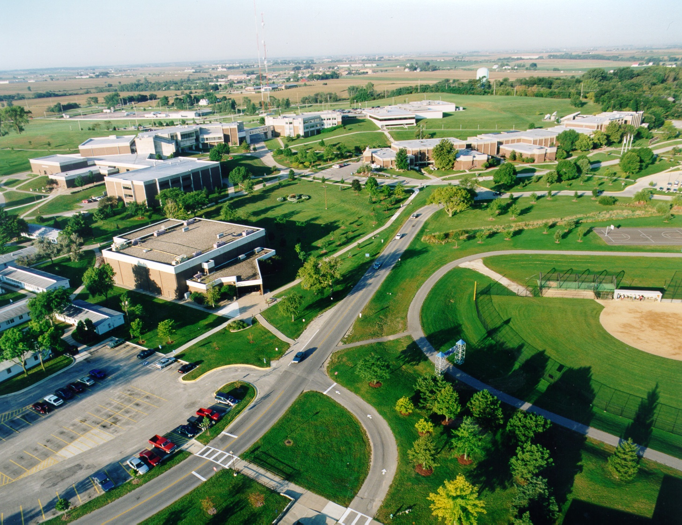
Kirkwood Community College
“Aligning the activities of the college with the goals and needs of the community enhances the impact of the college’s services”
800 acres

Slide 5
Workshop
Objectives
Building
Regional
Employer Engagement
Business Involvement
Deepen our understanding of employer-focused boards
Understand starting with the end in mind – outcome driven strategies
Examine the institution’s, division’s, department’s, or program’s readiness
Understand what it takes to commit to employer involvement and engagement
Discuss challenges and strategies to engage employers in boards
Sector Approaches
Examine sector approaches and strategies
Discuss how to build trust with employers and encourage expanded relationships
Learn how career pathway strategies fit and why they are important
Examine different pathway models
Discuss challenges and strategies with sector boards
Conduct sector diagramming
Workforce Public Policy - Iowa

Slide 6
Business Involvement
The Continuum:
Advisory Board
Industry Consortia
Sector Board
Multiple Missions
What It Takes

Slide 7
DEFINITIONS
Advisory Boards:
  Serve for the purpose of providing advisement and supporting regional cooperation in the areas of curriculum, facilities and equipment, instructional quality, educational delivery, and student employment.
    Meets minimum of twice each calendar
    Primary focus is on program curriculum, relevancy to regional workforce needs, and assessment of equipment used in the program that support theory and skills development
    Primary focus is on academic ‘for credit’ programs
    Members tend to be business and labor: owners, functional managers, or past graduates now employed in occupation representative of the program

Slide 8
DEFINITIONS
Industry Consortium:
  Serve in an adhoc role for the purpose of collaborating on joint education and training needs often across industry clusters. Industry consortium can be shorter-term in length, and function as long as the collaborative need exists.
    Meets as often as necessary
    Primary focus is on development and delivery training and education programs that currently don’t exist; awareness of existing training and education programs; and/or enhancement of existing training and education programs. Focus is largely on the needs of incumbent workers
    Primary focus is on professional skills enhancement ‘non-credit’ programs
    Members tend to be labor and business: owners, functional managers, and human resource managers

Slide 9
Sector Boards:
  Serve for the purpose of developing plans for building new skilled workforce pipelines for industry clusters that includes advisement of current programs, development and design of new programs, and direct strategies to support regional growth in a skills workforce. Business practices, education programs/practices, and policy barriers are key discussion points. Sector Boards also serve as Advisory Boards for many community college programs or clusters of programs.
    Meet monthly, longer-term boards versus shorter-term boards
    Primary focus:
      Workforce pipeline
      Education program enhancement, design, and development
      In-demand occupational and skills areas
      “How” to use the educational system and understanding “what” the educational system provides
      Focuses on ‘lasting’ change in the labor market system
    Primary focus is on academic ‘for credit’ and professional skills enhancement ‘non-credit’ programs
    Members tend to be business, labor, workforce investment board members, chambers, economic development organizations, labor, and community service providers.
Education
Strategy
Support
Strategy
Industry
Strategy

Slide 10
Comprehensive Community Colleges Multiple Missions
Workforce Development
  Proactive in their approach to develop education and training programs that meet the workforce development needs of regional and local employers and workers within the state.
  Strong partnerships with business, labor and industry are essential.
  Workforce training programs provide employers with a skilled workforce and participants with the skills necessary to compete in the regional and state job market.
  Administer numerous career and technical educational programs, job training and workforce investment federal and state programs.
  Workforce is important to the labor-market responsive community college.

Slide 11
Comprehensive Community Colleges Multiple Missions
Economic Development
  Workforce development is an economic strategy.
  The affordability, availability and capability of a region’s workforce is critical for economic growth.
  Business attraction, business expansion, quality of life, industry alliances, and community development are all influenced by workforce development programs.
  A strong workforce pipeline that supports the regional economy builds regional economic competitiveness.
  The college is the ‘community’s’ college

Slide 12
Employer Partnerships
Assessing:
>What It Takes
>Where Your College, Division, Department, or Program(s) is at on the continuum
What It Takes
  Organizational Standing
    Is the organization ready?
    Con long-term employer partnerships be supported?
  Aligning Missions
    Is there a commitment to align missions with employer partners?
  Readiness and Fit
    Are there economies of scale that support the partnership?
    Will the institution support the resources necessary to manage the employer partnerships? Labor partnerships?
Along the Continuum
  Engaging Industry Partners
    At what level do you want to engage employer partners?
    What board strategy best supports the college’s goals and the employer goals
  Building Industry Partnerships
    What level of resources are available
    what opportunity exists to leverage additional Wresources?
    Does the potential to grow and deepen the partnership exist?
      Assess potential
      Assess market niche and attractiveness

Slide 13

Networking
10 – 15 Minutes
Select Recorder
Select Presenter
Introduction
Name, Job Title, Organization
Experience with Employer Engagement and Partnerships
What are your questions about designing and implementing effective and engaged advisory board strategies and/or sector board strategies

Slide 14
Overview
Sector Partnerships
Employer Engagement
Systems Approaches
Strategy Approaches
Advisory or Sector Boards

Slide 15

Partners for a Competitive
Workforce
  A regional industry sector partnership is focused on growing the skills of the workforce to meet employer demand.
  Sector boards include businesses, workforce investment boards, chambers, educational institutions, labor, service providers and philanthropic funders.
  Key strategy: building career pathways that align education with employer needs in priority industries.
    Current sectors: health care, manufacturing, information technology, call center/customer service
    New sectors: transportation/logistics

Slide 16
A Systems Approach to Workforce Development
Targets a specific industry or cluster of occupations;
Intervenes through a credible organization, or set of organizations, crafting workforce solutions tailored to that industry and its region;
Supports workers in improving their range of employment-related skills and ability to compete for work opportunities of higher quality;
Meets the needs of employers; and
Creates lasting CHANGE in the labor market SYSTEM
Why – to stop running into the same barrier time after time
What – changing institutional factors that affect how workers connect to jobs:
  Business practices (hiring, promotion, work organization)
  Education practices (available/accessibility of key certificates, degrees, credentials)
  Policy barriers (funding, regulation of education and business)

Slide 17
Strategy Approaches
Key Principles of Sector-Based Approaches
One strategy to engage employers and partners
Employer leadership; demand-driven
Target priority sectors and in-demand occupations
Regional collaborative partnership
Career pathways and industry-recognized credentials
Education and training program review, enhancement, and development
Focus on multiple skill levels; job seekers and incumbents
Dedicated intermediary staffing
Focus on workforce pipeline challenges

Slide 18
SECTOR WORK
Strategy Approaches
Elements Necessary for Sector Strategies to Succeed
Collaborative Leadership
  The process of facilitation and operating in multi-organizational arrangements to solve problems that cannot be easily solved by a single organization
  Focus on pulling stakeholders together
Collaborative Mindset
  Able to see across boundaries, seeing connections and possibilities where others might see barriers and limitations, with a vision of what collaboration can accomplish
  Understanding the need to be inclusive and interactive
  Build synergy

Slide 19
Strategy Approaches
Elements Necessary for Sector Strategies to Succeed
Systems Thinking
  Discipline for seeing the interaction between the whole and its parts
  Habits of thinking
    Impacts on the future
    Ripple effects or consequences beyond the immediate concern/challenge
Strategic Thinking
  Defining problems in ways that focus attention and stimulate urgency
  Identifying and defining end-outcomes or desired results
  Identifying stakeholders and determining their goals

Slide 20
What is a Sector Strategy
Organizations or stakeholders connected to an industry for the purposes of developing plans for building new skilled workforce pipelines where shortages exist and providing ongoing relevancy in enhancing current skill delivery
Provides a means to engage directly with business and industry across traditional boundaries
Identifies strategies to align state programs, supportive services, education/training curriculum and other resources serving “businesses” and “career seekers”
Can impact the increase in per capita income for community and career seekers
The strategic focus of this process can lower the overall unemployment rate and impact the availability and capability of the regional workforce
Provides a framework to leverage ‘for credit’ and ‘non-credit’ resources and employer connections
Sector or Industry Partnership are a key strategic element within some of the most successful state and local workforce development efforts in the country.
(Aspen Institute)

Slide 21
Outcomes: Obtaining Education Institution Goals
Advisory Board
Increased access to feedback and input on professional-technical programs
Access to expertise to enhance and build the professional-technical programs
Increased co-ops and internships
Increases institution attractiveness – exposure of institution across multiple organizations
Sector Board
Increased financial and equipment resources for professional-technical programs
Increased foundation giving for scholarships
Acknowledgement from the community as a partner in economic development (opens doors for land, buildings, and other capital requests with city, county, and state officials)
Increased enrollments
Increased ability to hit ‘gainful employment’ performance metrics (retention and completion metrics)
Affects student attraction – seen as ‘education to career to employment’ institution
National recognition for workforce strategies
Creates a waiting list for Advisory Board and Sector Boards
Through Advisory Board
and/or
Sector Board Approaches

Slide 22
Differing
Vantage
Points
Advisory Board
Very college focused
Asking for industry partners to review current program content and provide feedback
Asking for industry partners to review new program ideas and assist in providing feedback
Asking for industry partners to advise on adequacy of equipment, assist in acquiring equipment, and make recommendations on equipment
Asking for a review of instructor qualifications and assistance in locating adjuncts
Asking for internship opportunities
Meetings led by Faculty or Deans
ALL IN TWO MEETINGS A YEAR!
Sector Board
Very industry driven
Focuses first on the goals of the industry partners and then on the college’s goals
Industry leads the meetings and sets the agenda
Meets more often, provides base to grow engagement, enthusiasm and commitment long-term
Colleges utilizes as a forum to get feedback and advisement in the program areas needed
Industry actively engaged in workforce pipeline development work in the region

Slide 23
Industry Sector Board
Representing the Program Cluster
Advanced Manufacturing
Various Options
What Makes the Most Sense Based On:
College Program Needs
Industry Partner Workforce Needs
Industry Cluster Workforce Needs
Machining and Manufacturing AAS
Advisory Board
Welding Technologies AAS
Advisory Board
Advanced Manufacturing Sector Board
Advanced Manufacturing AAS Advisory Board
Energy Systems Technology AAS Advisory Board
Advanced Manufacturing Sector Board

Slide 24
Networking
20 Minutes
Select Recorder
Select Presenter
Report Out
25 Minutes
Larger Questions about Advisory and Sector Board Strategies
What models are in use at your institution?
What do you see as the strengths and challenges with these models?
What does good employer engagement look like?
What employer engagement challenges do you have?
What have you found to be effective?
What resources are needed to support advisory or sector board development and sustainability?

Slide 25
Partnering with
Employers
Effective approaches to gain the
involvement and support
of the employer community
Building Trust
Expanding Members
Creating Meaning
Keeping Employers at the Table
Avoiding Individual Agenda

Slide 26
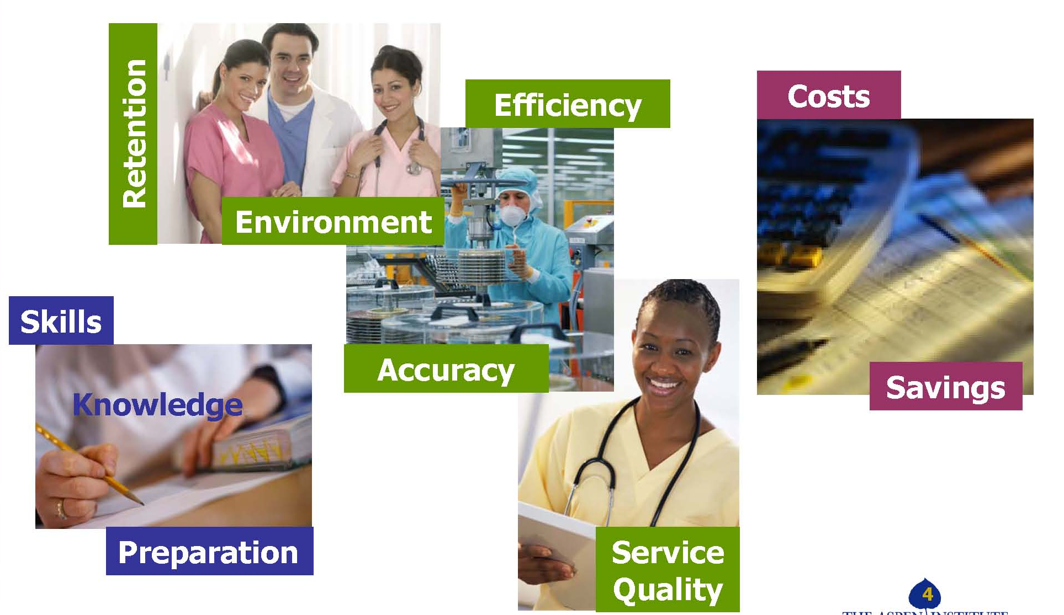
Value
From the Employer Perspective

Slide 27
Building
Trust
With
Employers
It takes considerable time and effort to establish a strong relationship with employers
  A genuine interest in the employers’ success
  Employers’ perspectives are utilized to frame the relationship
  Promote added value and reduce wasted time
  Nurturing is extra work
  These are your ‘success stakeholders’
If we agree that it takes considerable time, how do you accomplish this
  Clear role where responsibility for the relationships reside (faculty, Dean, facilitator, program manager)
  Performance and evaluation criteria include success with employer relationships and engagement
  Sufficient time and support provided to succeed in the task

Slide 28
Encouraging
Expanded
Partnerships
Win-Win
Focus
Brokering
  Act as broker to support the employers’ access to additional partners or resources that support their success
  Access to:
    community-based organizations
    institution’s career services division
    faculty and students
    continuing education or contracted training resources and products
    labor / trades
Relationships Among Members
  Support the relationship between/among the employers by understanding:
    the metrics of the employers
    the hiring processes of the employers
    the competitive factors of the employers
    how labor wants to be engaged in the conversations and partnerships
    students who have been hired by the employers
    current business investments
    customer base and size
  Through agendas and conversation strategically connect employers
  As employers ask for assistance, when appropriate, get them talking to each other to learn about best practices

Slide 29

Identify
Meaning
Recognize and plan for varying partner agendas in creating actively engaged employer partners
  Multiple Partners = Multiple Agendas
  Ensure agendas benefit both the employers as well as the institution
  Accept agenda items from employers and incorporate rallying points for all
  Incorporate individual wins where possible
  Excuse employer partners from the process when their agendas or objectives can’t align

Slide 30
What Threats
Do You Pose
To Your Employer Partners
Confidential material
  ensure that confidentiality is maintained
Human Resource and Training Departments
Productivity drain with no identifiable results
  Have they served on a committee in the past with the college and was that a successful experience
Business commitments – need to be clear if you are requiring commitment to interview, hire, endorse
Be aware of
concerns or perceived threats your employer partners may bring regarding you, your program or your institutions

Slide 31
Keeping Employers At The Table
Quickly find a smaller representative of the larger group to lead
Have short-term wins and long-term strategies
Have a plan for recognizing employers and individuals
Let employers set the communication plan
Have employers talk with students
Take responsibility for the hard stuff
  You do all the work
  Employers will support some work in-between meetings, but the college picks up the bulk of the work from their direction
Follow through on communication after and in-between meetings
  If changes to a curriculum were determined, be sure to communicate that it was made and what the impact was

Slide 32
Identifying, Accepting & Planning Against Individual Entity Focus and Agenda
Business/Employer: exist primarily to “make a profit,” employees/employment are a means toward a goal
Labor: apprenticeship programs; program partner; business partner; identification of industry competencies; certifications; employer outreach
Business Associations: are business member driven through membership fees
Workforce Development System: primary focus is on the success of an “individual” and “secondary” focus is on business/employer workforce needs
Non-profit/community organizations: built around a mission with funding/services directed to secure mission outcomes; marketing and recruitment; support services
Government/Regional economic development (most specifically those agencies involved in workforce development): designated to serve a target audience and provide a specific menu of products/services, using delivery methods meeting predefined success outcomes. Includes local political agendas at local, state, national level
Education: focuses on academic guidelines, success of the individual and meeting community needs which includes regional business/employer needs
Funders of the work of the partnership: may be comprised of all of the above, may be donors/contributors to the institution
Target audience: wants career or career advancement and may bring to the work their frustrations built from unsuccessful education attainment or experience, previous layoff, economic status, etc.

Slide 33

Business
Agenda
Identification
What is the agenda for business to be involved in workforce programming or program development/enhancement?
They are interested in a workforce that can assist in obtaining profitability goals!
What frustrates business members?
The lack of skill set present in the existing workforce
Internal pressures around workforce acquisition
Workforce pipeline
“How” to use the system or “what” the system is
The fragmented nature of the system
Repeated attempts to solve the problem
Being talked at, “the dog and pony show”

Slide 34
How do Career Pathway Strategies Fit?
Why are Pathways Important?
You are the experts!
Career Pathways
Sector Models
Use of Data

Slide 35
How Do
Career Pathway Strategies Fit
Career Pathways are one type of sector strategy that builds programs and ladders to better jobs
Provides on-ramps and off-ramps. No loss points. Focuses on credential attainment at each step along the pathway
“A series of connected education and training programs and support services that enable individuals to get jobs in specific industries, and to advance over time to successively higher levels of education and work in that industry. Each step on a career pathway is designed to prepare the participant for the next level of work and education.” (Workforce Strategy Center)
Includes creating an educational and support system that is aligned with career steps in a particular industry

Slide 36
Why are Pathways Important?
Understanding of job opportunities, foundational skills, and middle skills needed in the regional labor market
  What good jobs are available in the region?
  What skills/credentials do people need for these jobs?
  Supports industry knowledge, business relationships, and ongoing discussions with businesses about their workforce needs and challenges --- critical to program enhancements and development of new programs
Understanding of regional worker populations
  Who are the customer/student audiences these pathways/programs designed to serve?
  What skill and educational levels do they have?
  What remediation needs do they have?
  What barriers are preventing them from succeeding?
  What challenges do they face in the classroom, the program and the labor market?

Slide 37
Sector Work
Develop career pathway maps for occupational ladders/lattices and education ladders/lattices
Sounding board for education and training product and program development
Share perspectives on industry trends, occupational growth, recruiting needs, pipeline challenges
Employer leadership; demand-driven
Collaboration among many partners (businesses, workforce investment boards, chambers, educational institutions, labor, service providers and philanthropic funders)
Strategies

Slide 38
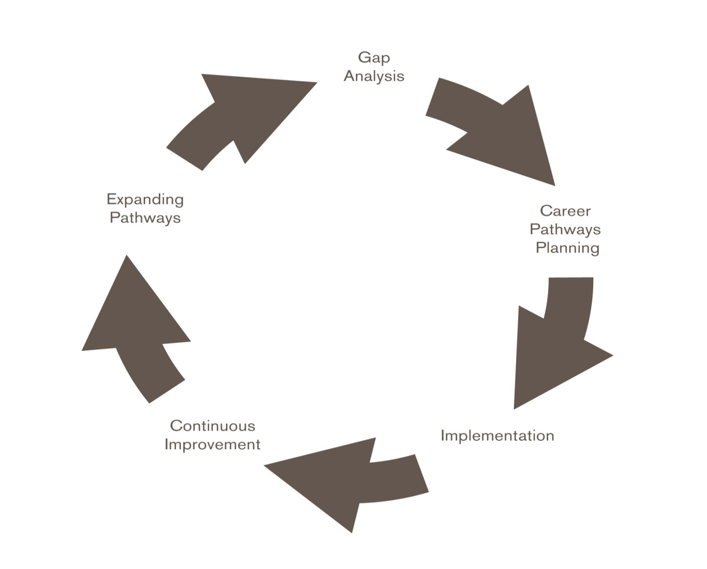
Career Pathways Process

Slide 39
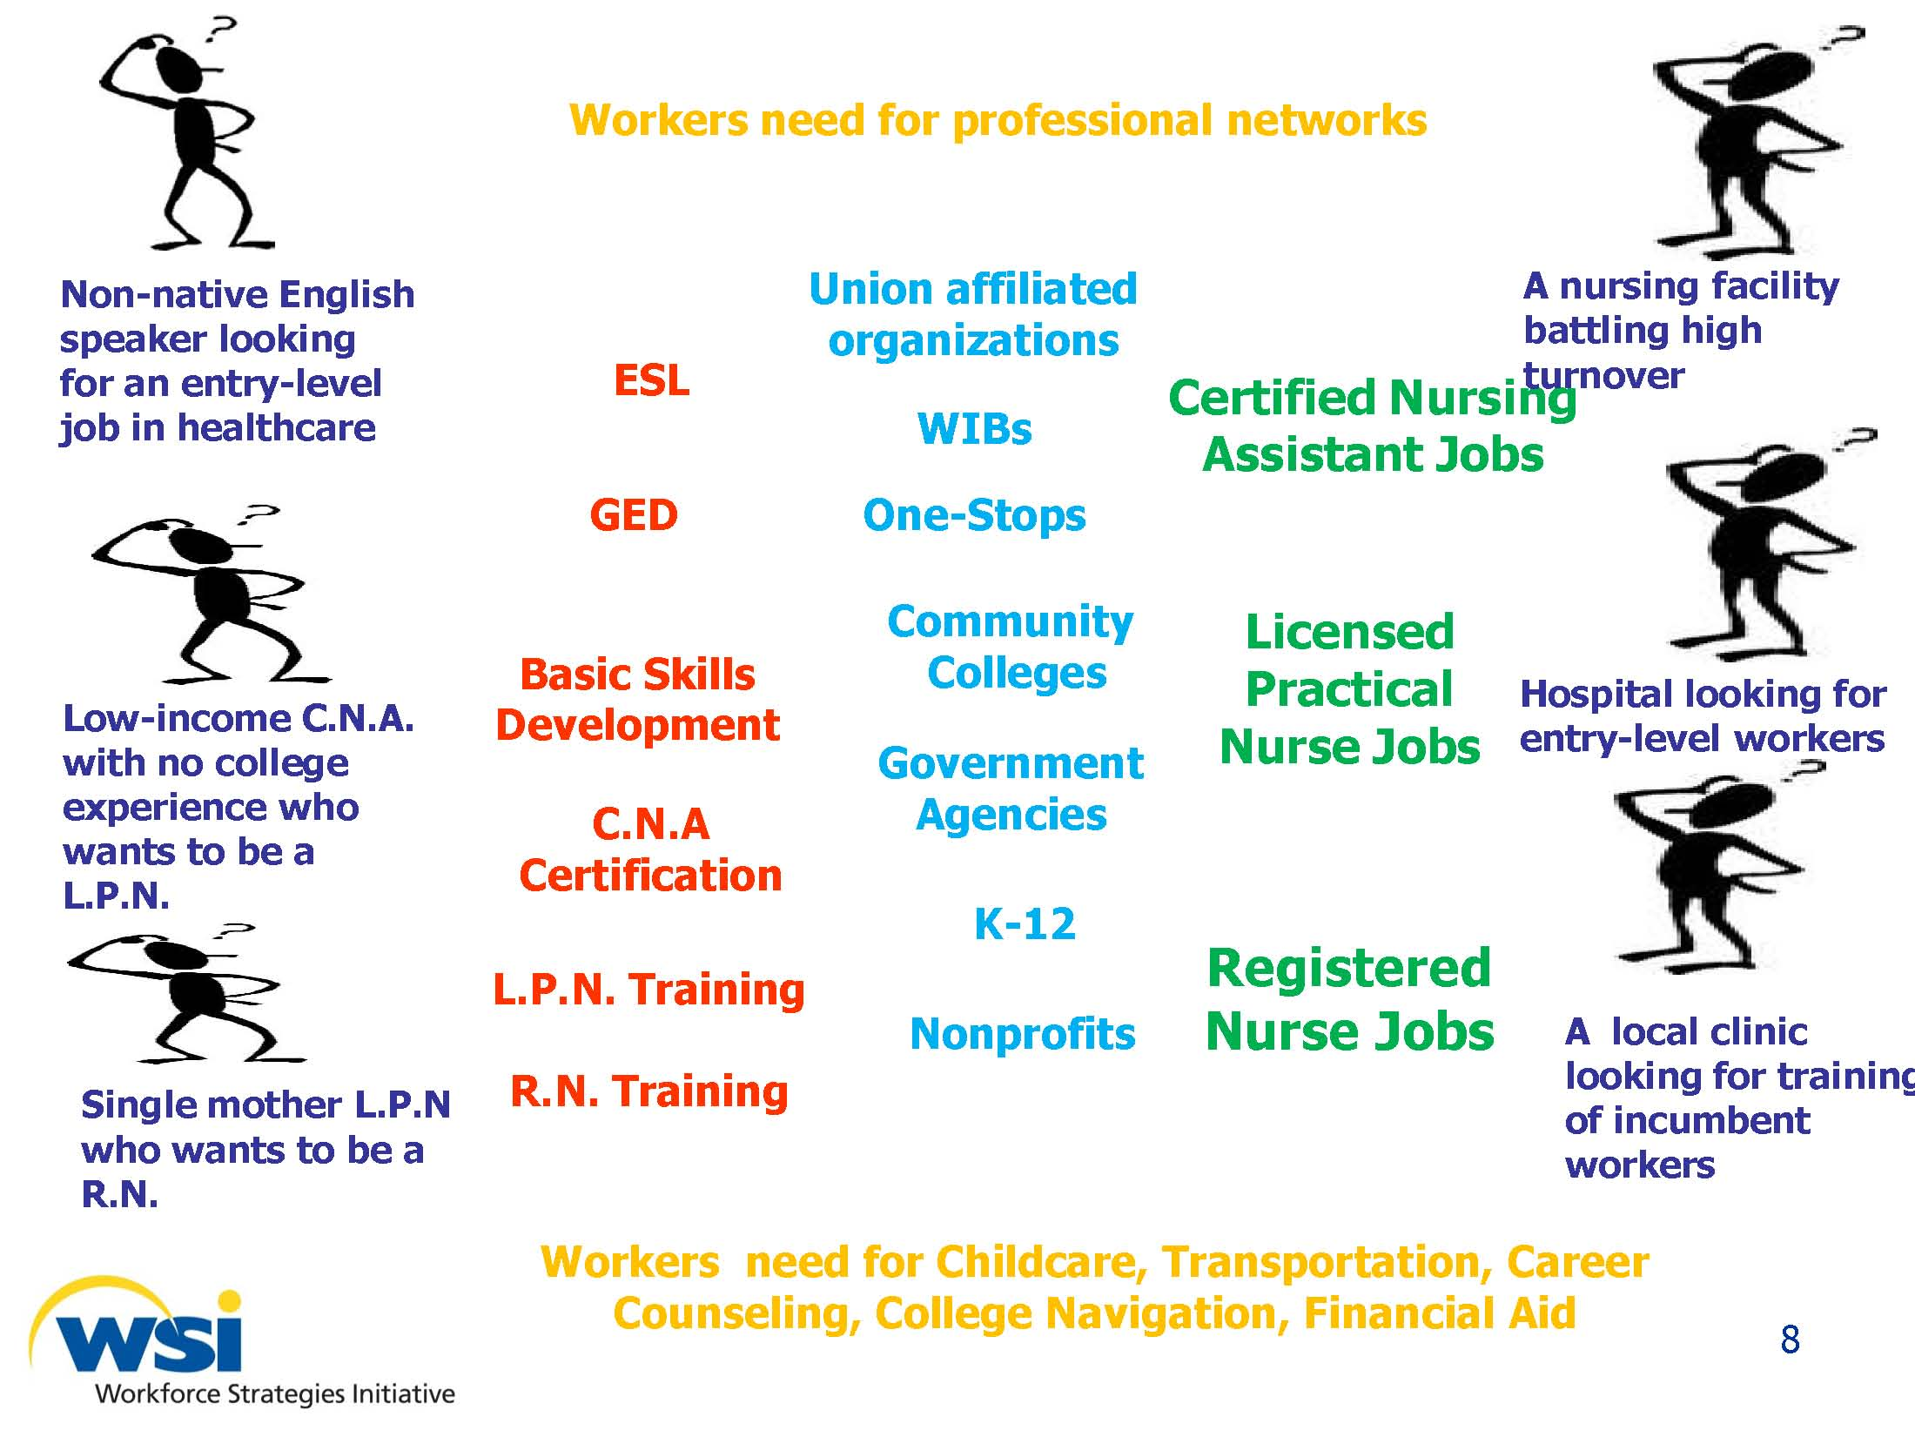

Slide 40
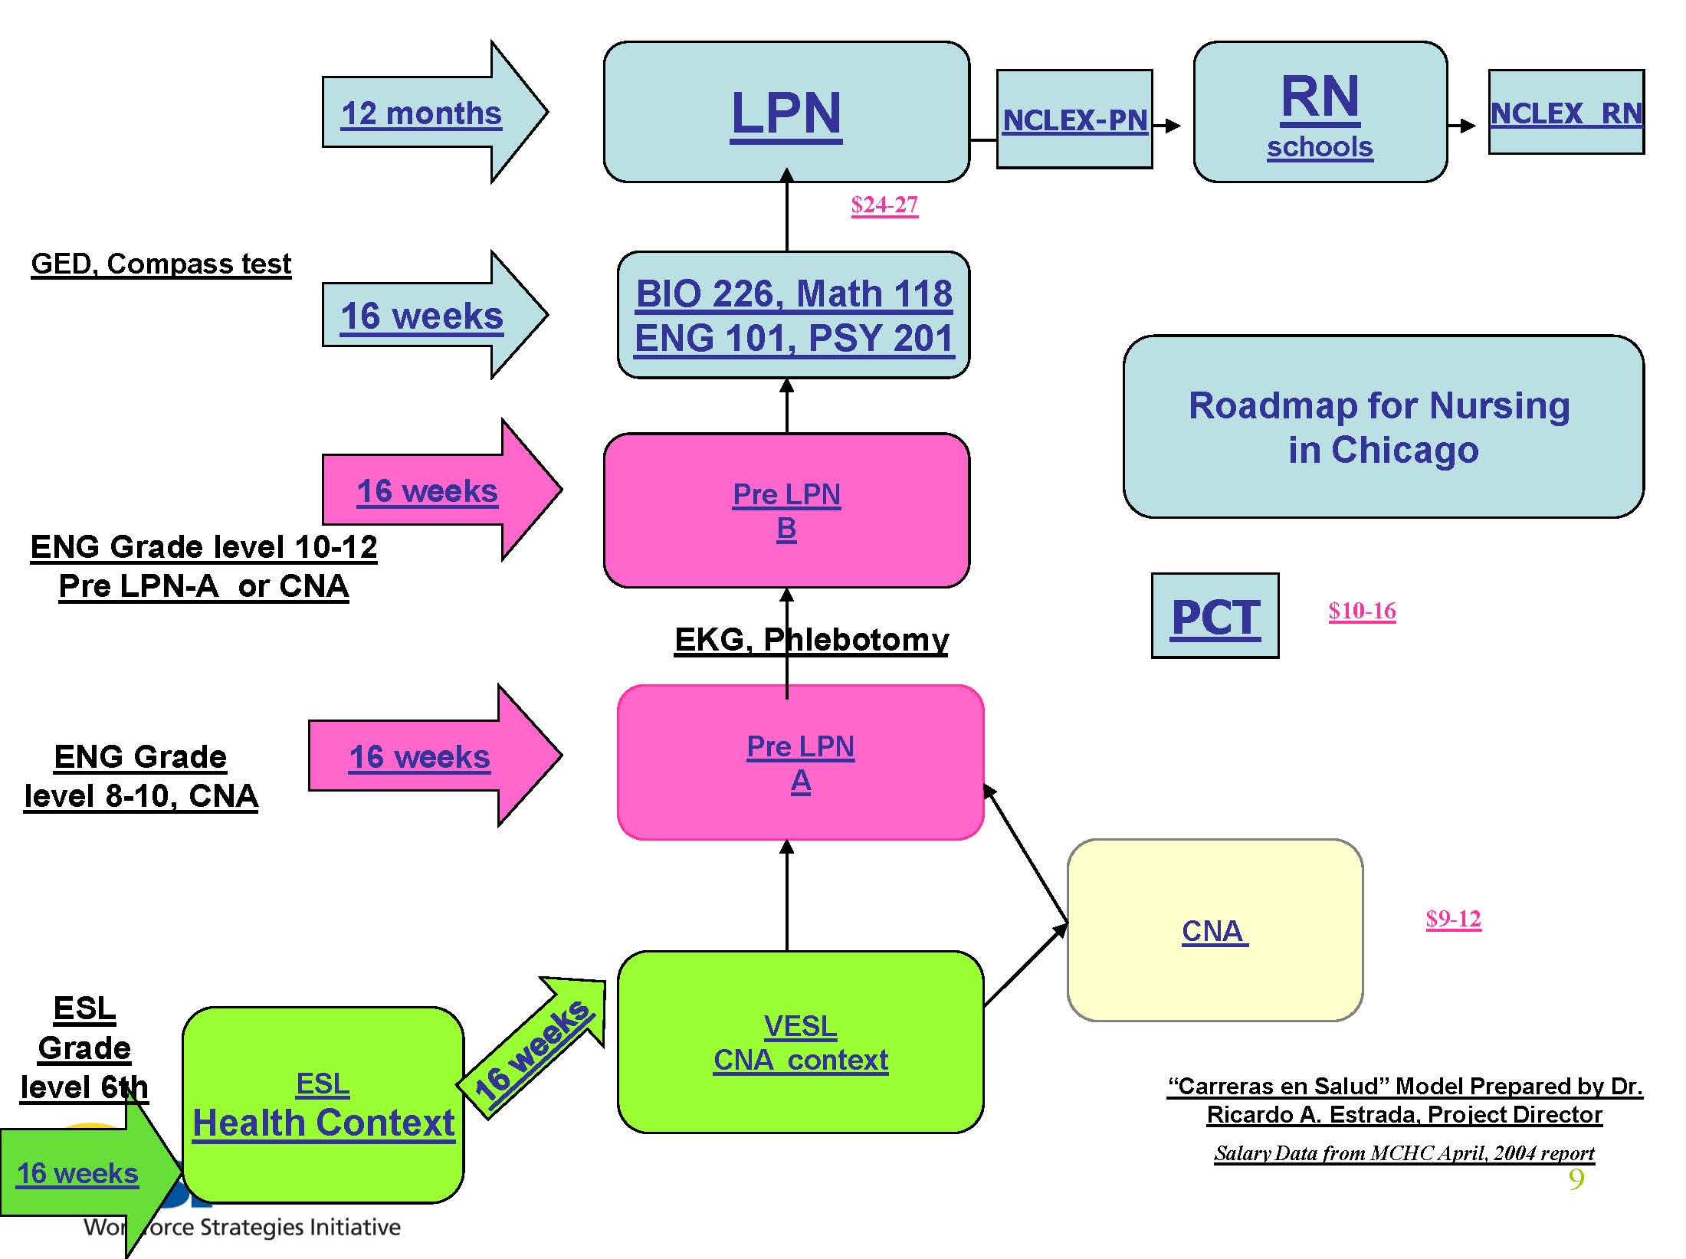

Slide 41
Region 10 Advanced Manufacturing
Career Pathways Map
 |  | ($29 - $48/hr)*
Business and Industry Experience, Proven Leadership Skills |  | Executive, Senior Leadership |  | 4-year Degree, Demonstrated Industry Exp. |  | Zone 6
 |  | ($22 - $38/hr)*
Experience with Contracts, Advanced PC Skills, Mechanical Desktop, ProE, Leadership Skills, Strategic Thinking, Organizational Planning |  | Manager, Engineer |  | 4-year Degree + Experience + Certifications |  | Zone 5
 |  | ($14 - $26/hr)*
Accounting, ERP and Analysis, Technical Product Knowledge & Experience, Presentation Skills |  | ERP Analyst, Sales, Technical Customer Service Representative |  | Certifications and/or 2-year Degree |  | Zone 4
 |  | ($17 - $29/hr)*
CAD Design/Modeling, Programming, Mechanical/Electrical Intermediate and Troubleshooting Skills, Coaching, Delegation, Mfg. Experience |  | Machine Tech, CAD Designers, Electronics Tech, Supervisor, CNC Programmer, Procurement Specialist |  | AAS or 3 years Experience |  | Zone 3
 |  | ($13 - $22/hr)*
CNC Skills, Instrumentation, Teamwork, Problem Solving, Negotiation & Customer Service Skills, Mechanical/Electrical Basic Skills |  | Fabricator, Welder, CNC Operator, Material Handler, Scheduler |  | Some Postsecondary, Experience and/or Certifications |  | Zone 2
 |  | ($10 - $22/hr)*
Personal Effectiveness Skills, Academic Competencies, Multi-Tasking, Organizational Skills, Attention to Detail, Mechanical Aptitude, Blueprint Reading |  | Production Workers, Assembly Operators, Product Inspection Finishers, Office Support |  | High School/GED |  | Zone 1
*Base wage rate not including benefits. 11/10/11

Slide 42
Region 10 Advanced Manufacturing
Educational Pathways Map
Industry-Wide Technical Competencies CNC Skills, Instrumentation, Teamwork, Problem Solving, Negotiation & Customer Service Skills, Mechanical/Electrical Basic Skills
Occupational Titles
Fabricator | CNC Operator | Welder | Material Handler | Scheduler
Zone 2
AWS Robotics
AWS D1.6 Structural Stainless, GMAW Horizontal
AWS D1.2 Structural Aluminum, GMAW Horizontal
AWS D1.3 Structural Sheet Steel, GMAW Horizontal
FMA Precision Sheet Metal Operator
AWS D1.6 Structural Stainless, GTAW Horizontal
AWS D1.2 Structural Aluminum, GTAW Horizontal
AWS D1.3 Structural Sheet Steel, GTAW Horizontal
NIMS Level 1 CNC Mill
NIMS Level 1 CNC Lath
PPE
CPR
First Aid
OSHA 10 Hour
Forklift Operations
Welding, Two Year A.A.S.
    Pipe Welding Certificate
Combination Welding Certificate
Welding, One Year Diploma
  Shielded Metal Arc Welding Certificate
Advanced Manufacturing Engineering Technology | CNC Machining Technology Diploma | Career Welding Certificate | Forklift Certificate
Zone 1
Industry-Wide Technical Competencies Personal Effectiveness Skills, Academic Competencies, Multi-Tasking, Organization Skills, Attention to Detail, Mechanical Aptitude, Blueprint Reading
Occupational Titles
Production Workers | Assembly Operators Production Inspection Finishers | Office Support
Intro to Manufacturing Certificate | Intro to Manufacturing Certificate | Business Computing Professional Certificate
National Career Readiness Certificate (credential) | National Career Readiness Certificate (credential) | National Career Readiness Certificate (credential)
Foundational Skill Competencies
Workplace Competencies
Business Fundamentals |  | Teamwork |  |  | Adaptability/ Flexibility |  | Marketing & Customer Focus |  | Planning & Organizing |  |  | Problem Solving & Decision Making |  | Working with Tools & Technology |  | Checking, Examining & Recording |  |  | Sustainable Practices
Academic Competencies
Science | Basic Computer Skills |  |  | Mathematics |  |  |  | Reading |  | Writing |  | Communication, Listening & Speaking |  |  | Critical & Analytic Thinking |  |  | Information Literacy
Personal Effectiveness Competencies
Interpersonal Skills |  |  | Integrity |  |  | Professionalism |  |  |  |  | Initiative |  | Dependability & Reliability |  |  |  | Lifelong Learning

Slide 43
Region 10 Advanced Manufacturing
Educational Pathways Map
Industry-Wide Technical Competencies Business and Industry Experience, Proven Leadership Skills
Occupational Titles
Executive, Senior Leadership
None
Zone 6
Industry-Wide Technical Competencies Experience with Contracts, Advanced PC Skills, Mechanical Desktop, ProE, Leadership Skills, Strategic Thinking, Organizational Planning
Occupational Titles
Manager | Engineer
Pre-Business | Pre-Engineering
Zone 5
Industry-Wide Technical Competencies Accounting, ERP and Analysis, Technical Product Knowledge & Experience, Presentation Skills
Occupational Titles
ERP Analyst | Sales | Technical Customer Service Representative
LEAN Certificate | Marketing Management | Technical Customer Service
Zone 4
Industry-Wide Technical Competencies CAD Design/Modeling, Programming, Mechanical/Electrical Intermediate and Troubleshooting Skills, Coaching, Delegation, Manufacturing Experience
Occupational Titles
Machine Tech | CNC Programmer | Supervisor | Electronics Tech | CAD Designer | Procurement Specialist
Industrial Maintenance & HVAC Technology | CNC Machining Technology |  | Electronics Engineering Technology | CAD/Mechanical Engineering | APICS
Zone 3

Slide 44
Using Knowledge and Data
To Build Successful and Engaged
Partner Boards
Data collection
Data analysis
Data informed
Key motivating and mobilization elements to:
  Form the board
  Engage the board
  Establish direction for the board
  Chart the focus of the board
Using Data to Drive Change: A guide for college access and success stakeholders; V. Dougherty, M. Long, & S. Singer; OMB Center for Collaborative Learning, July 2009

Slide 45
The Role of
Good Data
Gathering the Data /
Conducting the Scan – example
  Inventory current state and contributing factors
    What have enrollment trends been?
    Visibility/Recognition of the program in the region?
    Review student/customer demographics
      Satisfaction surveys
      Retention /completion rates
      Graduation rates
  Inventory external trends
    Environmental
      Unemployment rate impacts
      Workforce trends – occupational projections
      Regional – are labor and business growing
      Population – increasing or decreasing, what age groups
    Skill needs
      Along the career ladder have skill level requirements changed
      What are the required educational and credential levels
  Inventory competition
  Inventory partnerships
The Process Supports
Board engagement
  Involve the board in collective brainstorming around the “opportunity”
    Example ‘program declining enrollment’
  Invite open and honest discussion
  The process supports momentum to tackle the larger, more difficult challenges

Slide 46
Through Data Sources:
What Partners Are Needed
Questions to pose:
Who in our community (political, programming, public relations) needs to be part of the conversation?
Are particular employers/ organizations missing from our current partnership?
Among the employers/ organizations present, are there specific individuals missing?
Knowing the challenges we want to address or the direction we’ve determined, who has influence and capacity to help eliminate these challenges?
How do we bring these employers, organizations to the table and keep them there as long-term vested partners?
How do we bring additional employers, organizations to the table and stay true to the original vested partners?

Slide 47
Putting It All On The Table –
Data Sharing How-To’s
The capacity of data to drive change—partner suggestions:
Leave time to discuss and problem-solve data sharing challenges:
  Celebrate small victories when challenges are addressed
Respect partners’ fear of data:
  Not everyone embraces data
  Some fear what might be uncovered (internal to the college and board members)
  Discuss the fear and use it to build trust
  Must support critical self-assessment
Emphasize the positive aspects of data collection:
  Show how the partnerships are strengthened by sharing and understanding data
Find ways to present sensitive data anonymously:
  Remove names
  Give individual partners handouts with just their organization’s data
Provide opportunities for partners to digest data on their own
  Lead smaller group discussions
  Divide out the data and have small groups present
  Guide members to come up with key observations and implications
  Increase shared responsibility

Slide 48
Sector Strategy Models
Advanced Manufacturing
Insurance
Healthcare
Transportation and Logistics

Slide 49
Getting Started in Designing Employer Driven Programs
Stages of Industry-Led Program Development
  Need identification / data gathering
  Identify and invite industry partners to dialogue
  Need identification / data gathering
  Prioritize and project workforce needs
  Program development / build workforce plan
  Program delivery
  Success measures
  Program/student support services
  Fund and execute
  Determine sustainability

Slide 50
Getting Started in Designing Employer Driven Programs
Needs Identification
  Employer’s ability to grow depends on obtaining the right assistance at the right time for a given problem – or obtaining the right talent at the right time with the right skills.
  What are the employer’s problems related to training and workforce skill needs?
  What is driving this skill need? (educational levels, technology advancements, industry specialization)
  Where are the economies of scale, the central, common needs?

Slide 51
Getting Started in Designing Employer Driven Programs
Gather labor market information
  Employer workforce skills studies
    Skills 2014 Report
    Regional Labor Supply/Demand Report
    Business Expansion Strategic Trends
    Training Program Studies
    Occupational Skills Studies
  Widely publicize workforce skills studies and skills shortage data
  http://www.kirkwood.edu/site/index.php?p=32612

Slide 52
Getting Started in Designing Employer Driven Programs
Prioritize and project workforce needs / target programs
  Work with economic and workforce partners to determine data needs, scope, and format
  Clearly define and localize the data
    Listen to the feedback
    Hold focus groups with employers, employees and community organizations
  Develop a blueprint for business and education to work together
  Articulate recommendations and ownership for action items

Slide 53
Getting Started in Designing Employer Driven Programs
Program Development
  What type of program is being developed?
    Entirely new program/major at the institute
    Revision of current program/major at the institute
    Training course/program for an employer’s incumbent workers
    Pre-employment training program for individuals hired by an individual company or companies
  Is the program designed for one employer or many employers?
  What individuals will be served by the program and what results do you expect to realize?

Slide 54
Getting Started in Designing Employer Driven Programs
Program Delivery
  What will be needed to deliver the course/program?
    Facilities? Equipment? Faculty? Instructional Resources?
  What type of delivery is needed to best serve the student in the course/program?
    At the institute in classroom
    At the employer site
    Lab, clinical or internship requirements
    Skills assessments

Slide 55

Getting Started in Designing Employer Driven Programs
Success Measures
  How will success be measured?
    Program completers
    Graduates obtaining employment
    Satisfaction of employer partners
    Employer benefits derived
    Annual enrollment
    Program revenue
  What does success look like?

Slide 56

Getting Started in Designing Employer Driven Programs
Program/student support services
  Who will be targeted for this program?
  How will students respond to the program?
  What challenges will this population present?
  What staffing is needed to support the program?
  What resources will employers support/provide?
  What assistance will be provided for job placement?

Slide 57
Sector Strategy Models - Examples
Advanced Manufacturing – Kirkwood Community College
Insurance – Ohio Department of Development
Transportation and Logistics – Ohio Department of Development
Healthcare – City Colleges of Chicago

Slide 58
Welcome & Introductions
Rhonda Griffin – Centro Incorporated
Welcome
  Why is Centro Incorporated Involved
Introductions
Background – History
  The mission: To develop and sustain a comprehensive regional Advanced Manufacturing career pathway pipeline that is targeted to high demand jobs that meet the needs of employers, workers, and the available workforce.

Slide 59
Welcome & Introductions
Rhonda Griffin – Centro Incorporated
The Business Case
  Manufacturers have communicated:
    A growing concern for interest and preference for careers in manufacturing
    32% of manufacturers report a moderate-to-serious skills gap (State NAM Report)
    Manufacturers expect the skills shortage to worsen in the next 3-5 years (State NAM Report)
    3,211 new and replacement positions needed through 2014 (Skills 2014 Employer Survey)
    Existing skills gap in the areas of work-ready, foundational skills and advanced skill sets to support advanced technology in the industry
  An Educated and Skilled Workforce:
    Business innovation is a strategic imperative
    A highly skilled and educated workforce is one of the most critical elements for innovation success
    Regional Skills Gap is widening, qualified applicant pools are shrinking

Slide 60
Advanced Manufacturing Sector Board
What we are:
  Industry Driven
  A collaboration developing industry specific workforce strategies to address employers’ needs for skilled workers and workers’ needs for good jobs
  Development and deployment of industry-led actions that support development of the workforce pipeline/labor force
  Engaged employers working in partnership with all stakeholders K-12, higher education, workforce development, economic development, and the available workforce

Slide 61
Advanced Manufacturing Sector Board
Goals:
  Increase communication to all employers/partners regarding current activity involving industry, education and best practices
  Increase partnerships between employers, education, community-based organizations and workforce development to address the skills gap
  Develop and locate tools to better match people to manufacturing careers
  Develop a unified marketing and outreach program to improve the visibility, perception, and understanding of manufacturing careers
  Increase exposure to manufacturing through internships, tours, job shadows and faculty/instructor engagement

Slide 62
Advanced Manufacturing Sector Board
Goals:
  Serve as the advisory committee for the K-12 CTE Program Manufacturing Curriculum and Assessment and Kirkwood’s Advanced Manufacturing Program and Noncredit Manufacturing Certificate Programs
  Develop and map the career and education pathway for the Advanced Manufacturing Sector (Manufacturing Production Sub-Sector (Completed)
  Align the Advanced Manufacturing career pathway map with existing certificate, diploma and degree programs (Completed)
  Review current programs, identify gaps, seamless approaches, and determine needed technical standards, skills standards, and or program changes (On-going)
  Introduce industry credentials and certifications, determine value and return on investment

Slide 63
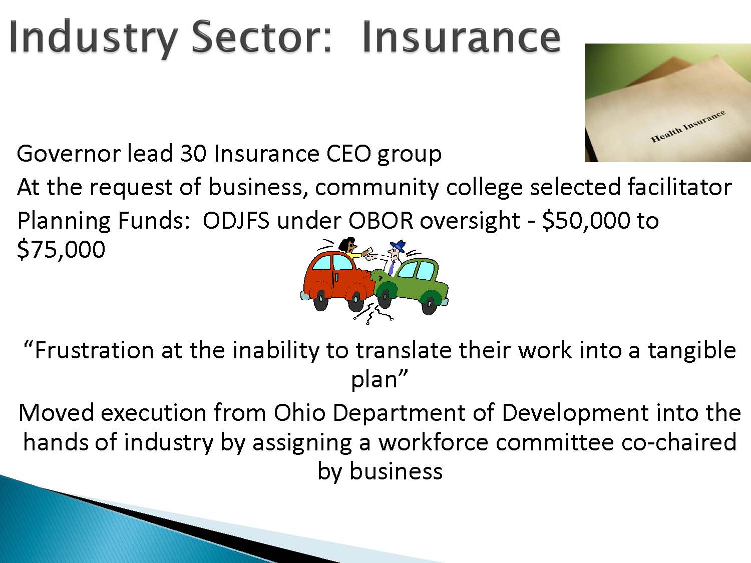

Slide 64
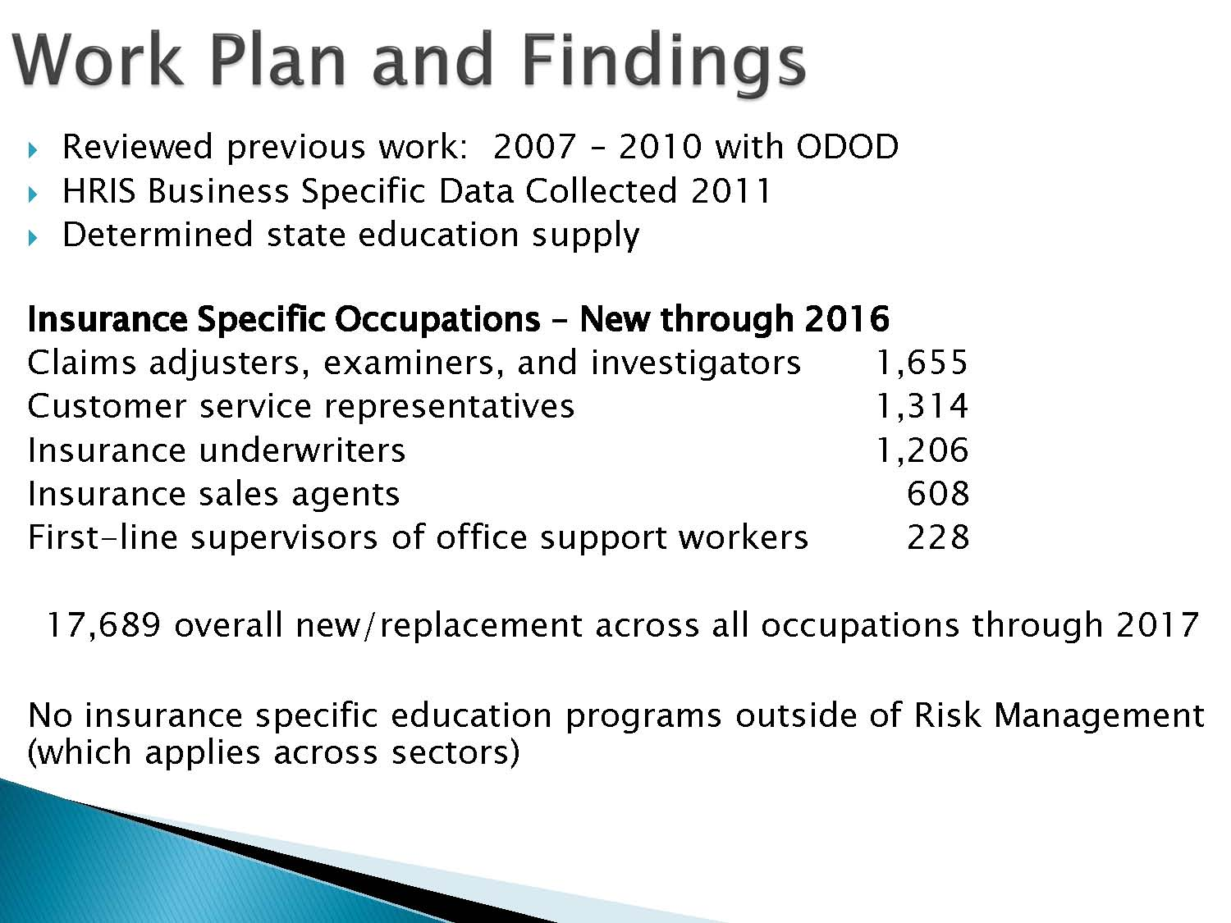

Slide 65
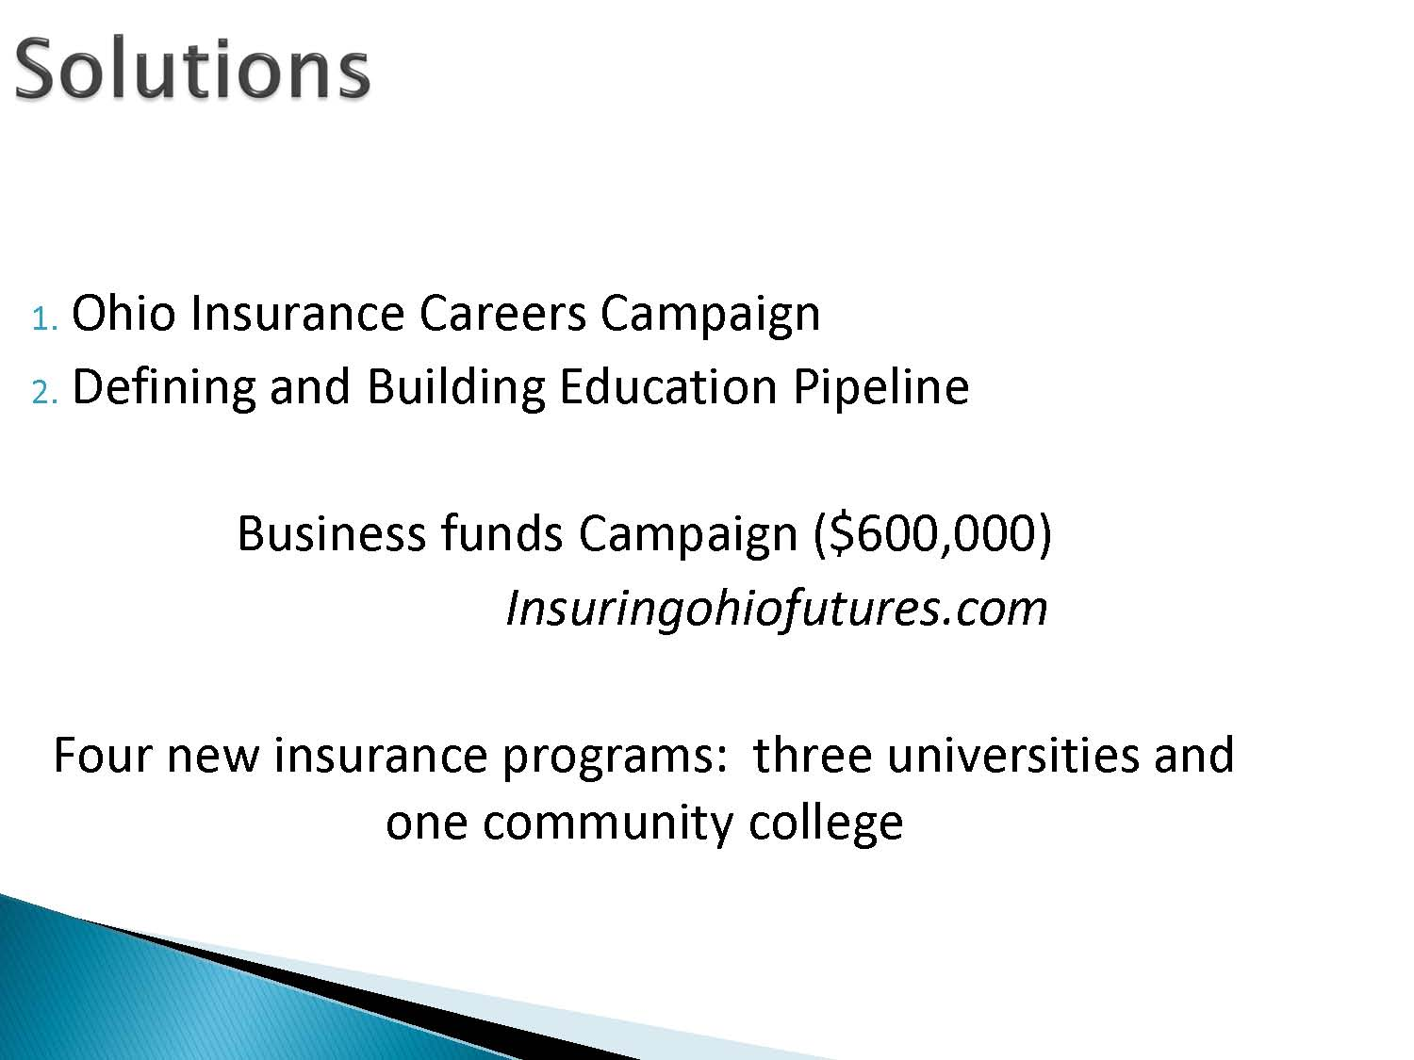

Slide 66
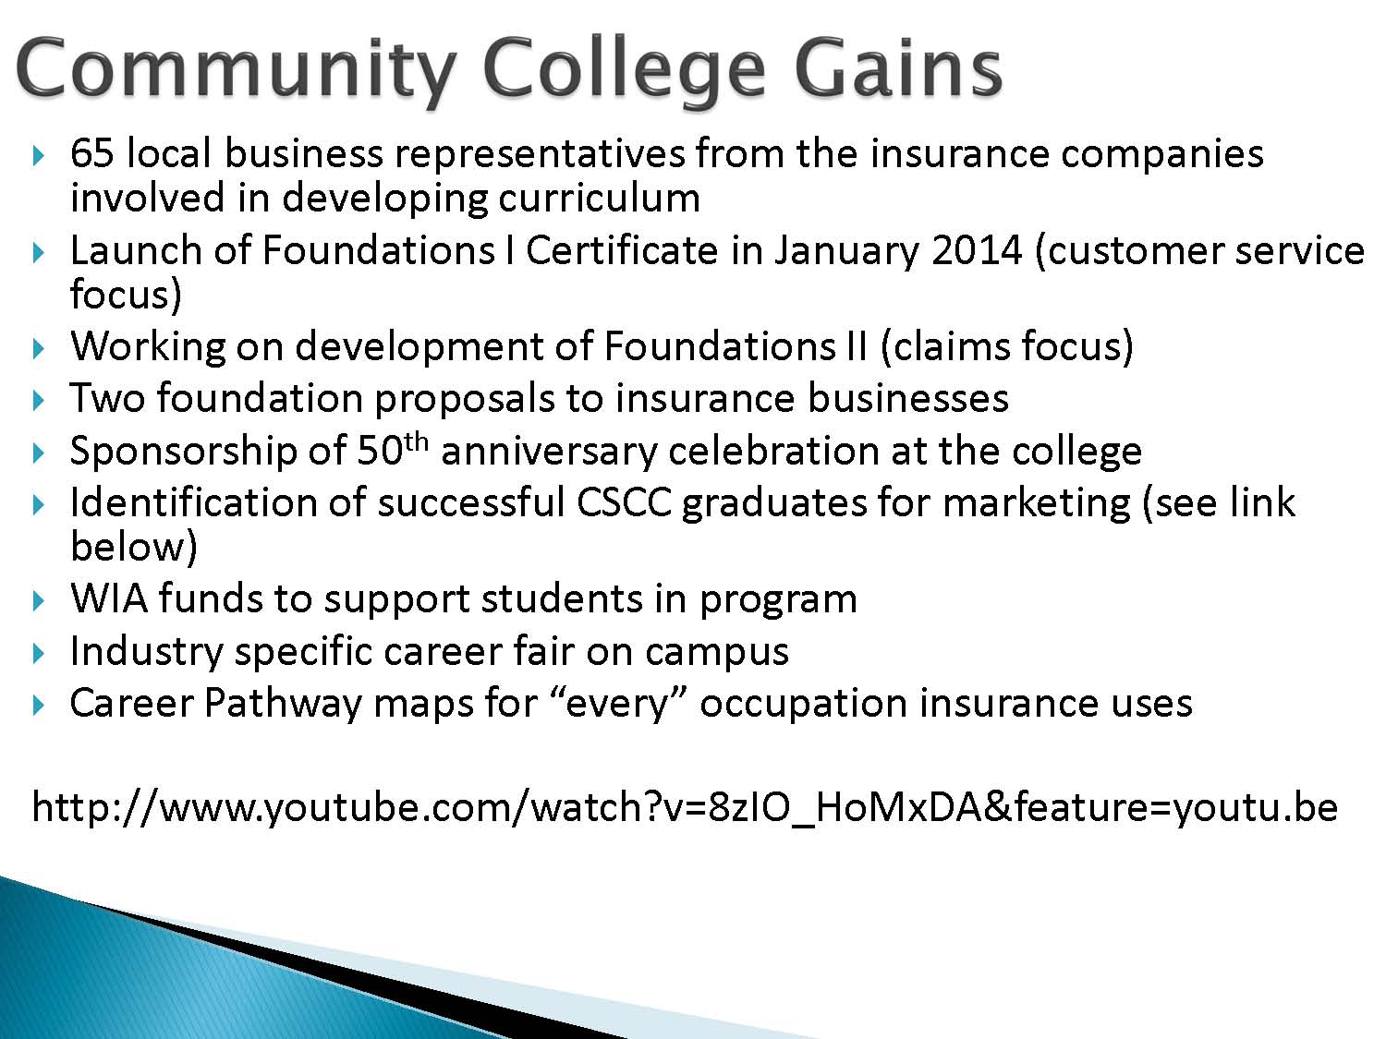

Slide 67
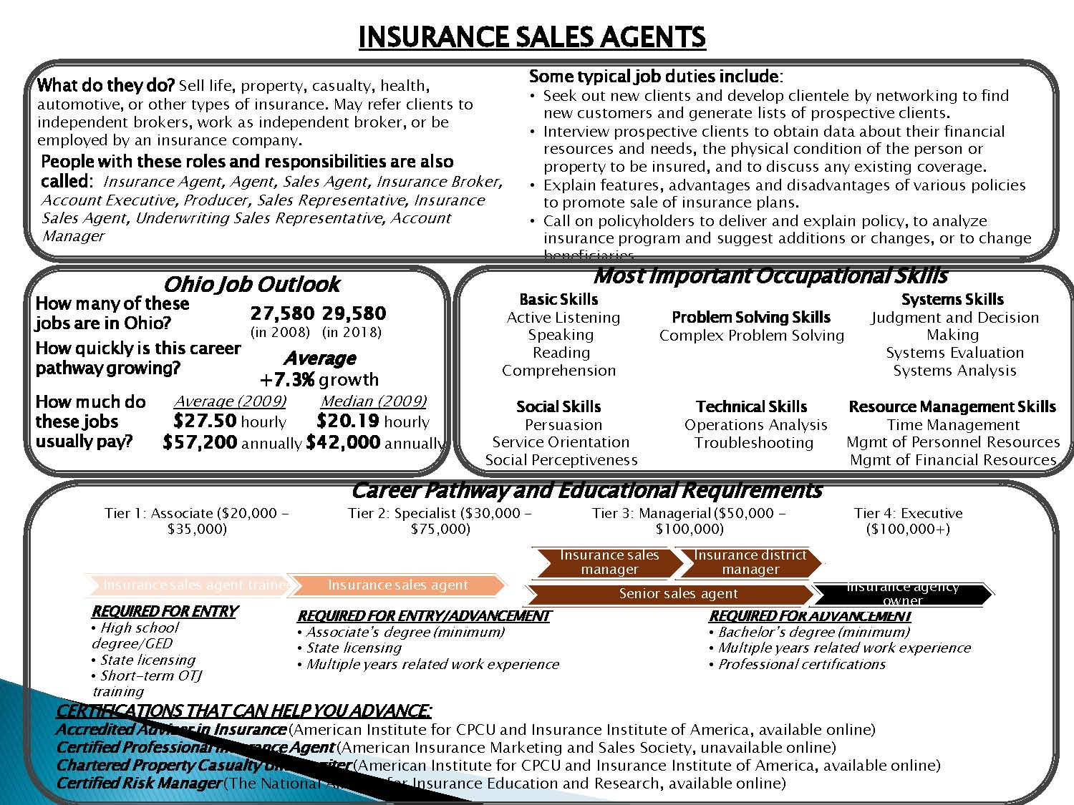

Slide 68
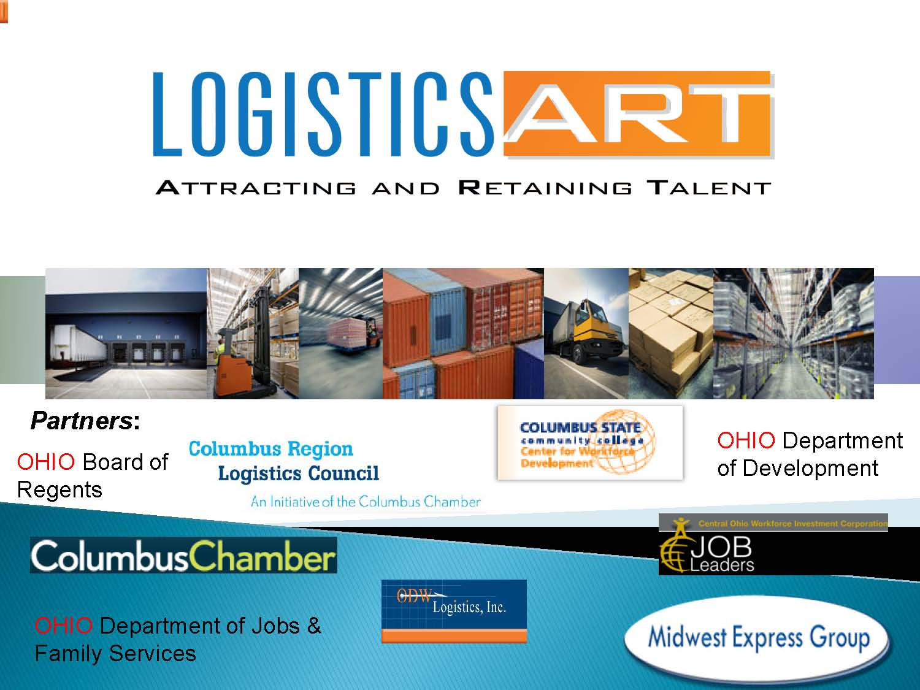

Slide 69
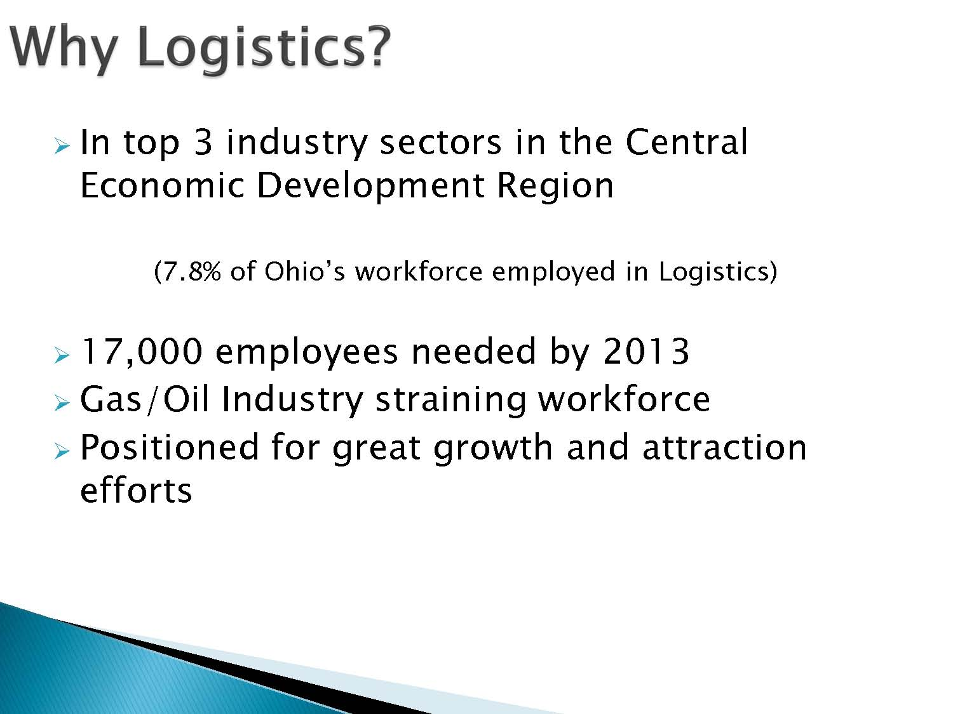

Slide 70
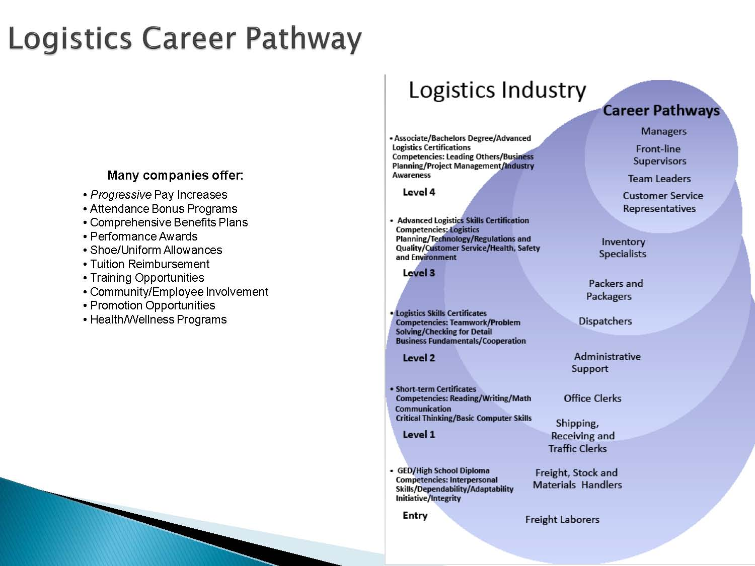

Slide 71
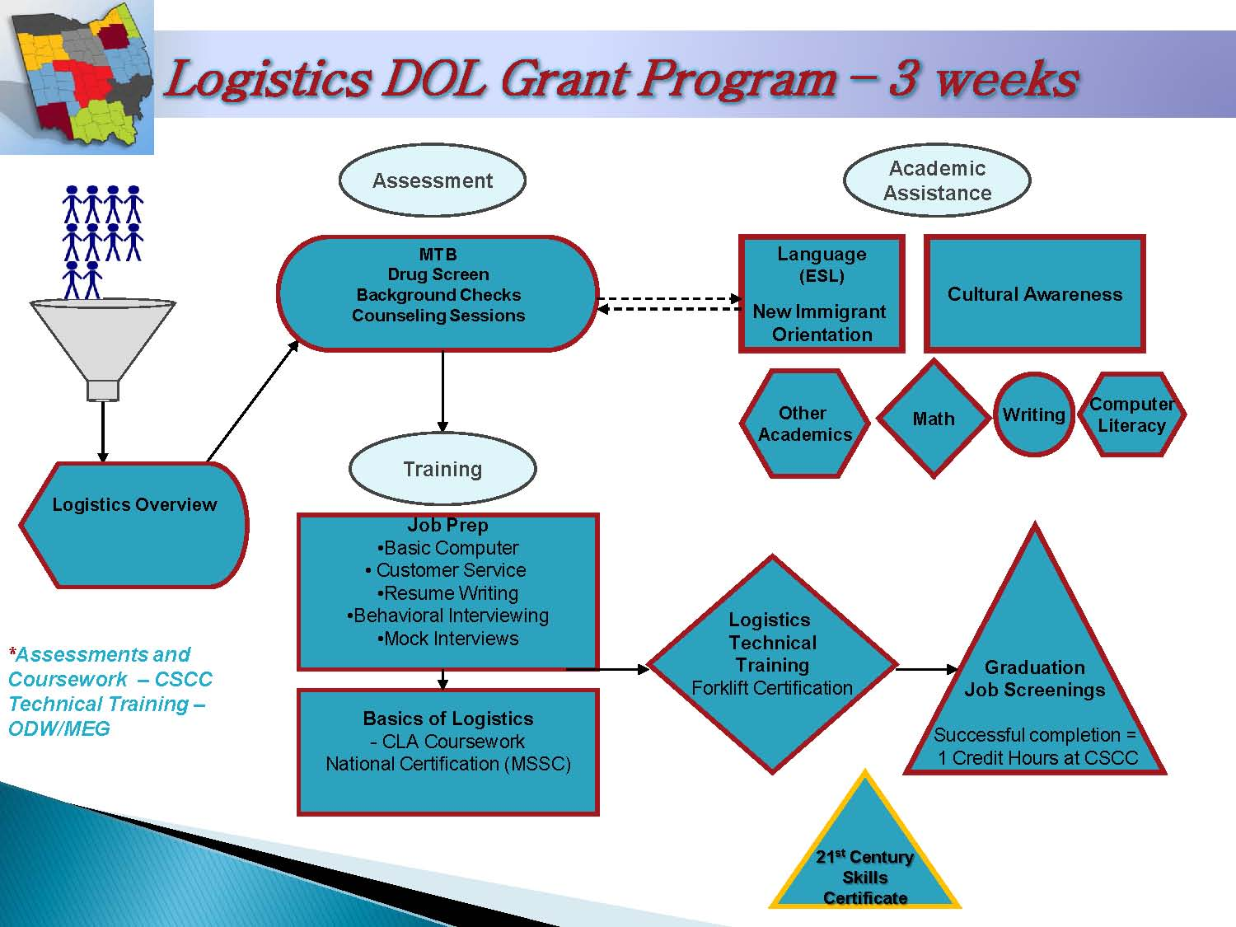

Slide 72
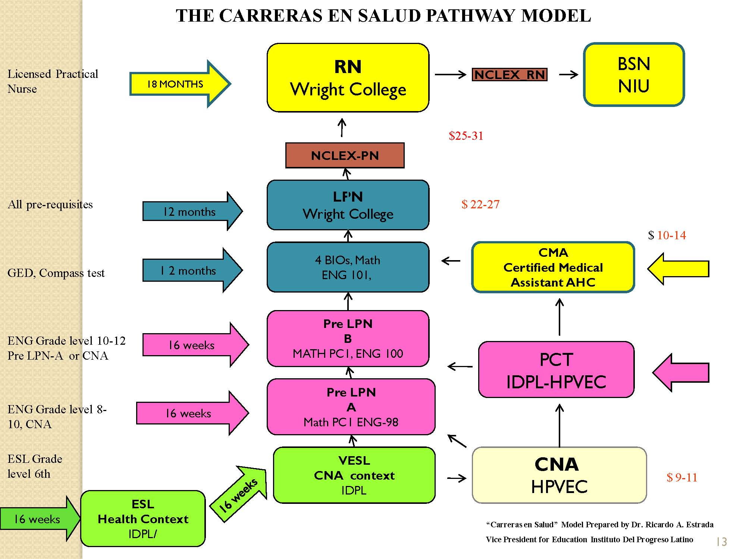

Slide 73
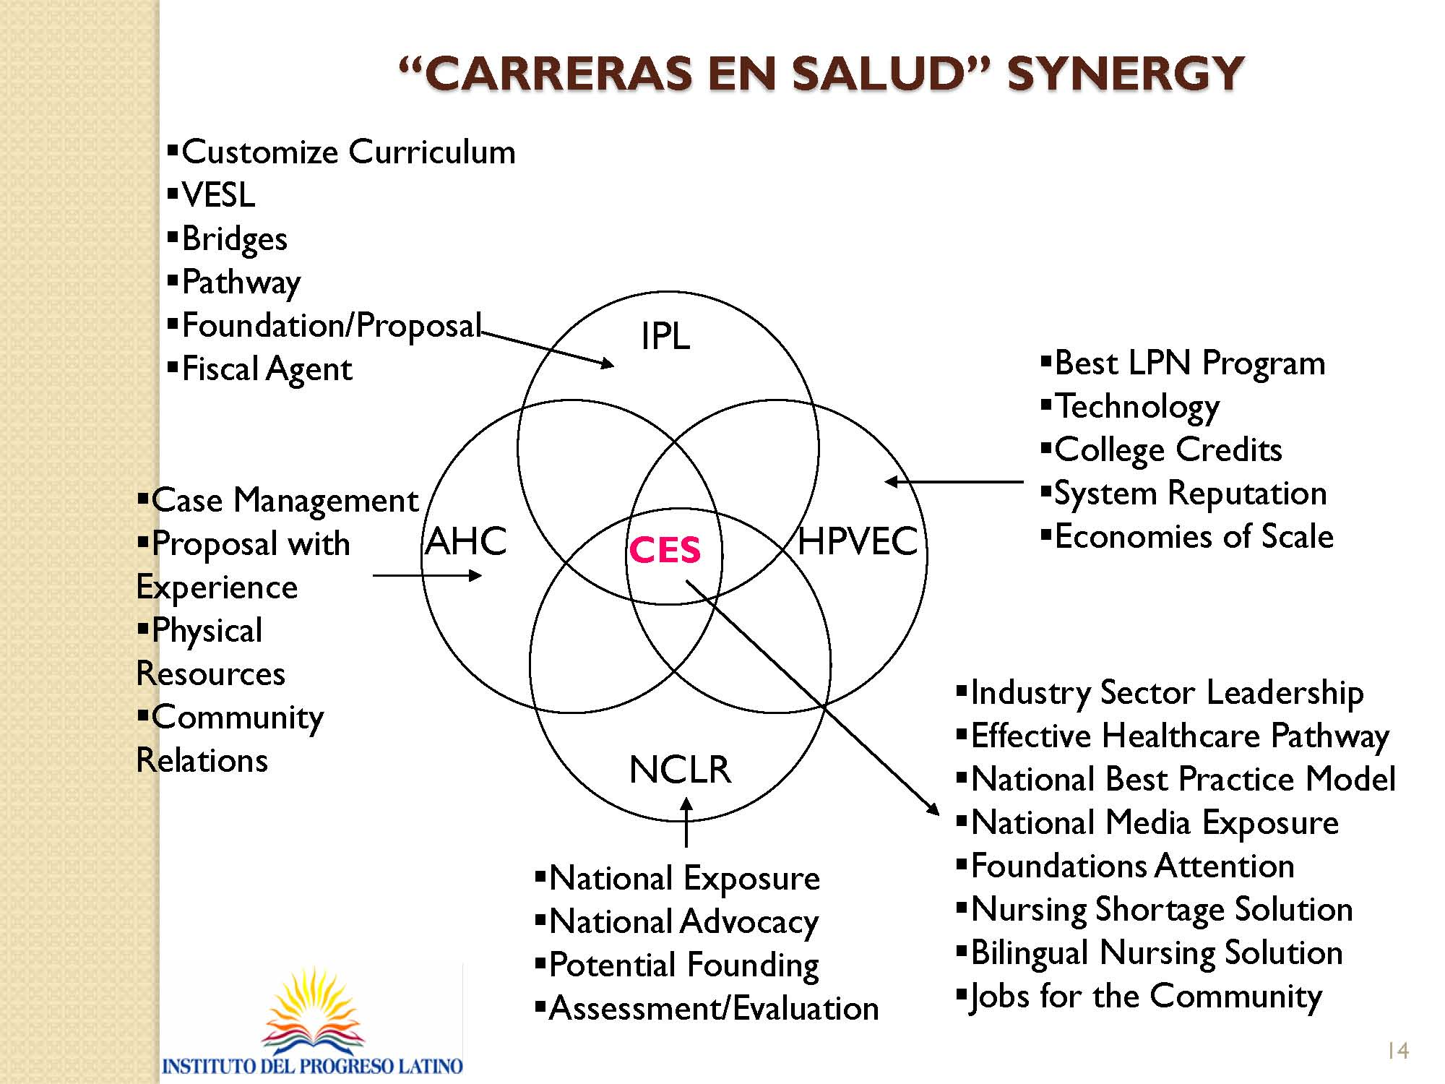

Slide 74
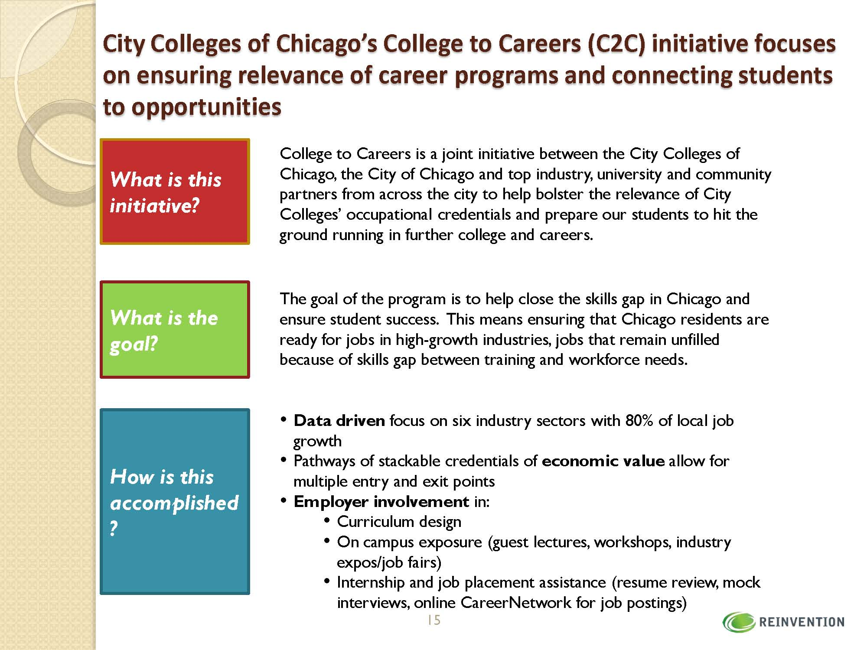

Slide 75
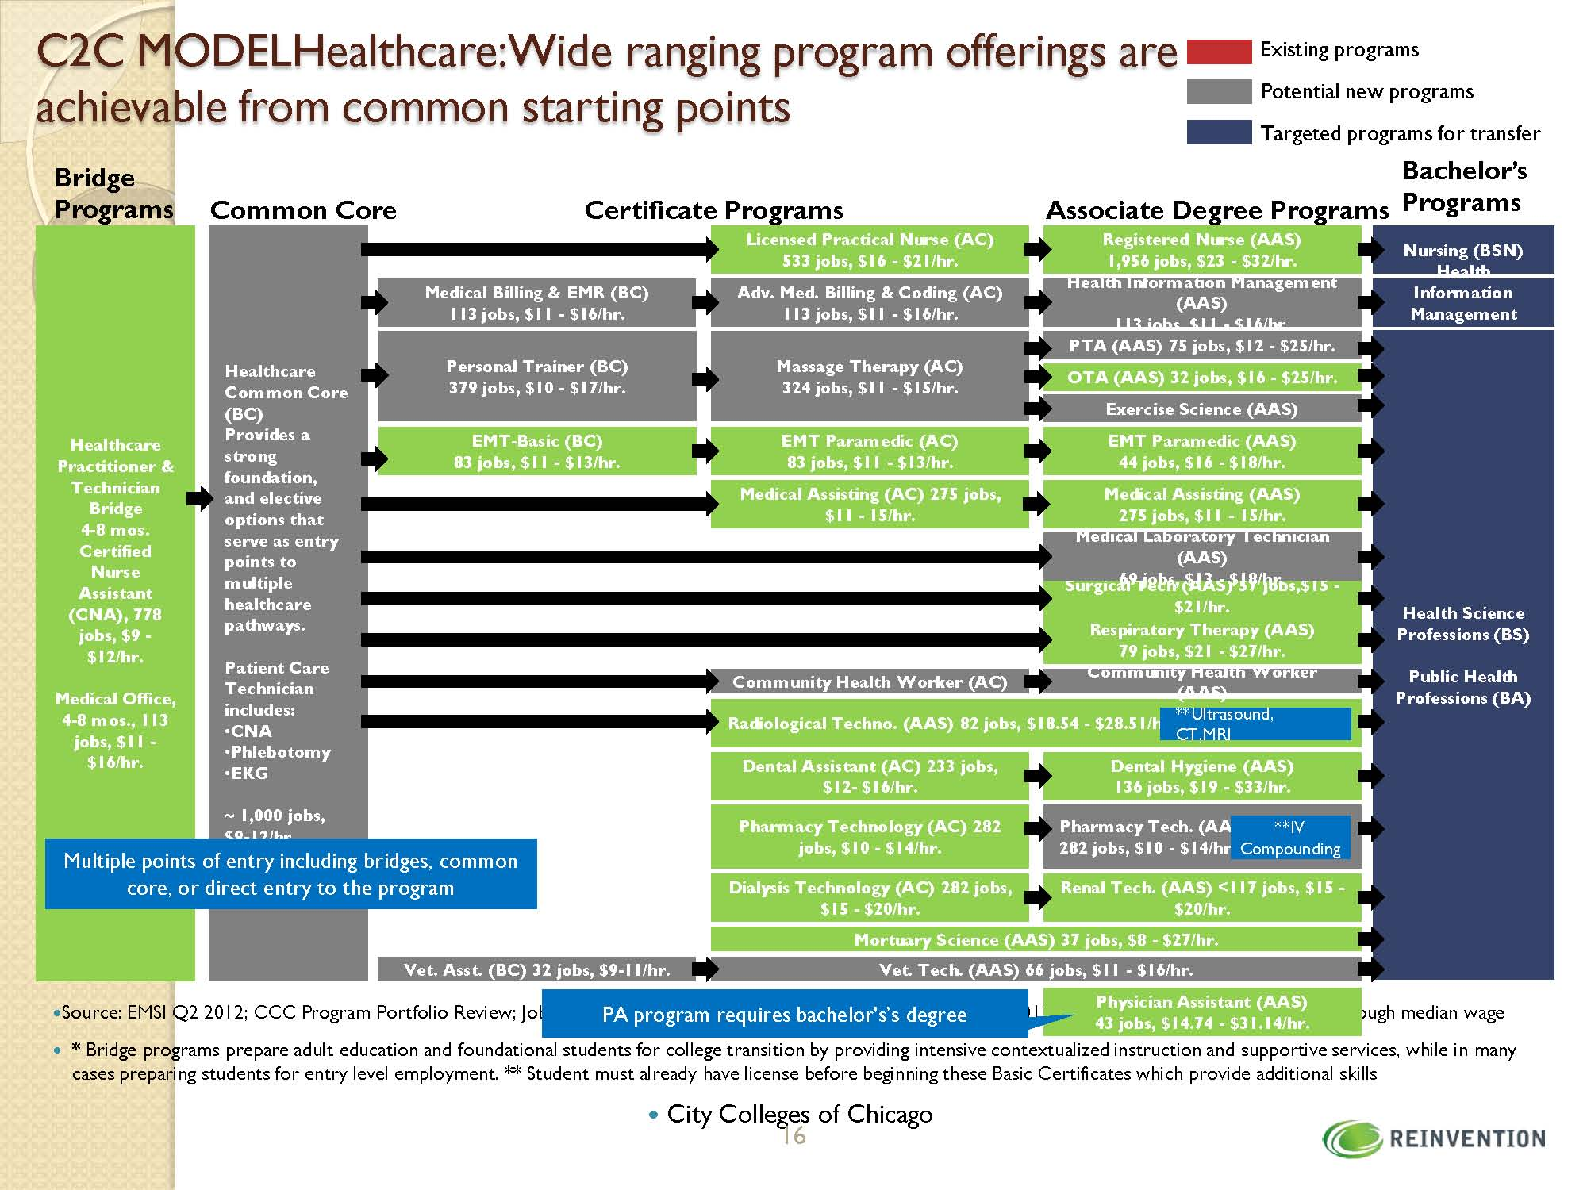

Slide 76
Sector Diagramming
Identifying the Key Stakeholders
in Your
Sector Initiative

Slide 77
Diagramming Your Sector:
Step 1
Step One (5 minutes): Think about the institutions, organizations, and agencies that are involved in your sector. Who are the key players? Quickly brainstorm a list of the principle actors in each of the “systems” in which your sector project operates. Go beyond institutional types and try to think about specific organizations or individuals that represent the following stakeholders groups or work in the following systems:
  Industry (employers, customers, trade associations, chambers of commerce, unions, or other industry actors);
  Worker constituent groups (e.g., ex-offenders, workers with limited English-language skills, youth, etc.);
  Workforce development entities (e.g., WIBs, One-Stops, CBOs);
  Education and training institutions (e.g., community colleges, trade schools, proprietary training providers);
  Support services providers (CBOs, religious organizations, public agencies);
  Others.

Slide 78
Diagramming Your Sector:
Step 2
Step Two (10 minutes): Think about your organization. How would you depict its relationship to each of the actors in the sector that you listed in Step One?
Use one of the blank sheets of paper in your folder to make a diagram of your organization’s relationship to some of the primary actors you listed under Step One. Code your diagram, so that organizations that are of more importance to your work are bigger and those that are of less importance are smaller. Put the organizations which you have a strong relationship with closer to your organization and those that you have a weaker relationship with further away.
KEY
Important partners: big, bigger. BIGGEST Less important partners: Small, smaller, smallest Close relationships: Close to your organization Distant relationships: Further away from your organization

Slide 80
Diagramming Your Sector:
Step 3
Step Three (10 minutes): Now imagine that you’re one of your partners. Pick one you know reasonably well. Use the second sheet of paper to draw/depict the relationships between this partner and the other actors in the sector from their perspective, as best you know it. Use the same codes you used in Step Two to demonstrate how these partners interact with one another – organizations that are of more importance to their work are bigger and those that are of less importance are smaller; organizations which they have a strong relationship with are closer to their organization and those that they have a weaker relationship with are further away.

Slide 81
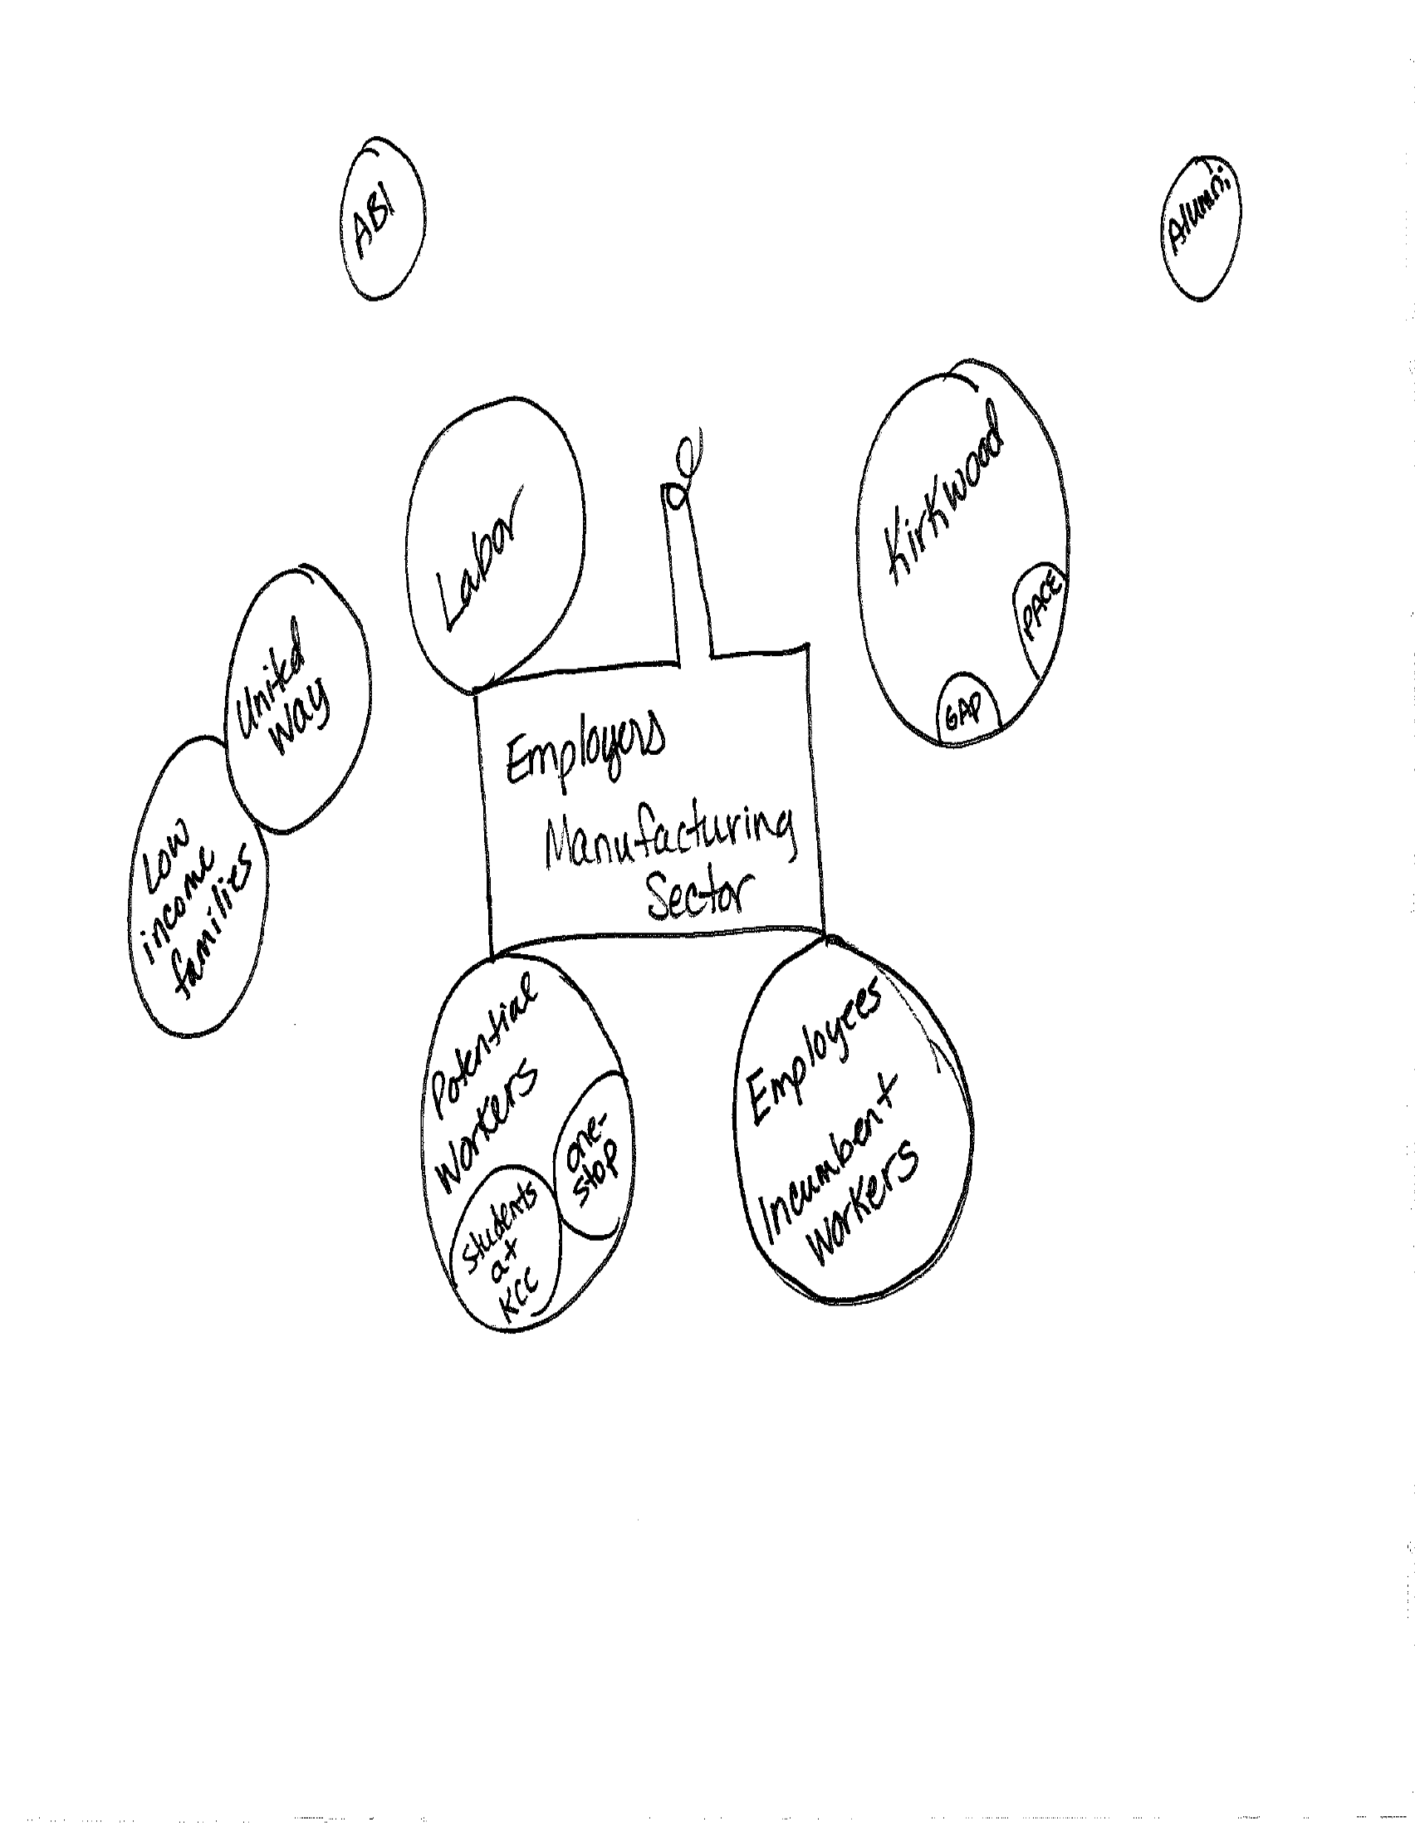

Slide 82
Diagramming Your Sector:
Step 4
Step Four (5 minutes): Once you’ve drawn this second diagram, stand back, and take a look at both diagrams side-by-side.
  How are the two perspectives similar? Different?
  How is your organization viewed by your partner in the sector?
  What relationships does your partner have that are or might be useful to you?
  What relationships do you have that are or might be useful to your partner? To potential partners?
  Are there missing relationships between actors that you might play a role in creating or strengthening?
  What services or competencies do you think you have to offer to the sector?
  Are there ways in which you might like to re-shape or influence this system?
  Does this view of the system shape your thinking about opportunities for creating change?

Slide 83
Diagramming Your Sector:
Step 5
Step Five (10 minutes): Pair off and present your diagram to a partner. Discuss:
  Who’s your strongest partner and why?
  What brings you together? What comes between you?
  Are there any surprises in your diagram?
  Are there any surprises in the diagram you drew from your partner organization’s perspective?
  Do you see any strengths you hadn’t thought of?
  Do any barriers become apparent in just looking at the relationships? Or, gaps where you might like to see something else?
  Are there gaps in your knowledge of your partners that you would like to address?

Slide 84
Workforce
Public
Policy
Making the case
for a
workforce policy agenda

Slide 85
The Need for Policy Change or
New Policy
Policymakers have limited time
Data needs to be presented succinctly to make the case for change or support
Case statements are critical
Consider these questions:
  What is the policy issue and what data do we have that clearly show that this policy impedes student access to or success in college?
  What is the policy change that we hope to see implemented?
  What are some policy best practices or precedents in other regions or related fields?
  What program models are showing promising practice that the public policy would support and bring to scale?

Slide 86
Iowa’s
Workforce Training and
Economic
Development
Fund
$12M
A workforce funding account created for each community college
Utilization of funds include:
  70% of the funds designated in the areas of advanced manufacturing, information technology and insurance, alternative and renewable energy, biotechnology, and health care
  For the development and implementation of career academies
  Employer training
  Career and technical education programs
  Career pathway programs
  Entrepreneurial education
Measures
  Enrollment
  Completion
  Employment
  Wage Gain
  Employers Served

Slide 87
Iowa’s
GAP
Tuition
Assistance
Fund
$2M
A workforce funding account provided to the community college for need-based tuition assistance to applicants for completion of continuing education certificate training programs for in-demand occupations
Continuing Education Certificate programs must:
  Be offered for non-credit
  Be aligned with a credit certificate, diploma or degree
  Offer a state, national, or locally recognized certificate
  Represents recognized skill standards defined by an industry sector
Program recipients must be 250% at or below the federal poverty level
Measures
  Certificate Programs Offered
  Enrollments
  Completion
  Transition to College Credit Programs
  Employment
  Wage Gain

Slide 88
Iowa’s
Pathways for Academic Career Education and Employment (PACE)
Program
Fund
$5M
Funding to community colleges for the development of pathways for academic careers and employment
Pathway programs must further the ability of members of target population to secure gainful, quality employment
Programs shall integrate basic skills and work-readiness training with occupational skills training
Programs shall support pipeline development in partnership with community-based organizations and industry partners
Funding can be utilized to support
  Pathway Navigators
  Sector Board Development and Facilitation
  Program Development
  Student Support Services
Measures
  Enrollment
  Credentials Attained/Completion
  Transition to College Credit
  Employment
  Wage Gain

Slide 89
Contact Information and
Websites
kim.becicka@kirkwood.edu
319-398-5525
www.kirkwood.edu/site/index.php?p=34949
www.kirkwood.edu/ceorwib
www.elevateiowa.com
www.kirkwood.edu/ce
www.kirkwood.edu

